Slide 1

Programing Clinic
Vehicle management
reporting person：Duan Youzhen
reporting time：03.06.2024
Notes:
模板来自于： 第一PPT https://www.1ppt.com/

Slide 2
Project ideas
Basic event flow：
Transport authorities are digitising their operations. They need a system where vehicles can be registered with details such as licence plate number, owner's name and vehicle type. In addition, they want to integrate licence plate recognition to monitor vehicles entering and exiting major urban junctions.
Notes:
模板来自于： 第一PPT https://www.1ppt.com/

Slide 3
Project ideas
Suggested methodology：
I should start by defining the use case diagrams, sequence diagrams and class diagrams for each use case. I will then use them to create the following process:
Registering new vehicles in the system
Identify and record licence plates at city intersections
For simplicity, it is assumed that the vehicle number plates will be provided to the program through a manually populated PostgreSQL server.
Use this resource to see various examples: Regtransfers UK
Notes:
模板来自于： 第一PPT https://www.1ppt.com/

Slide 4
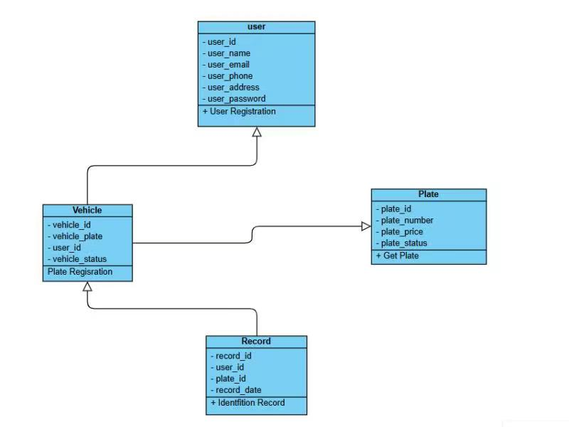
Project class diagram

Slide 5
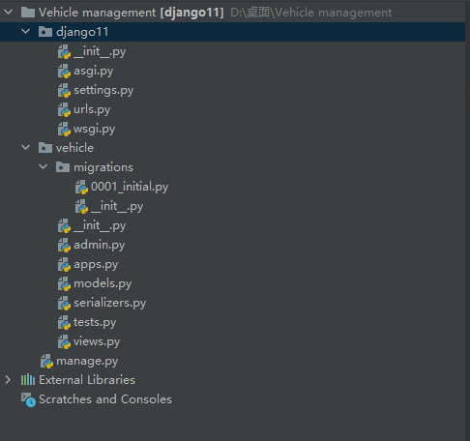
Project Catalogue
Notes:
模板来自于： 第一PPT https://www.1ppt.com/

Slide 6
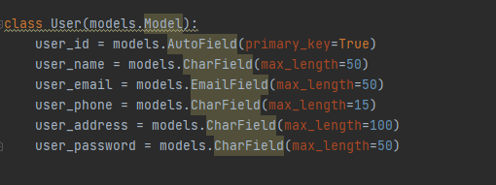
1. Owner's model
Notes:
模板来自于： 第一PPT https://www.1ppt.com/

Slide 7
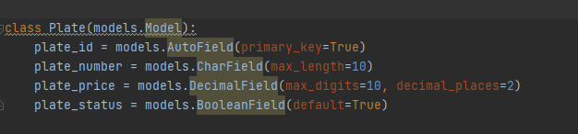
2. Licence plate number model
Notes:
模板来自于： 第一PPT https://www.1ppt.com/

Slide 8
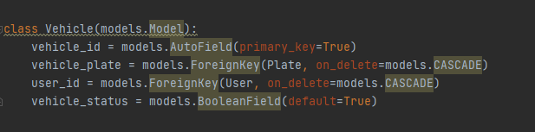
3. Registered licence plate number model
Notes:
模板来自于： 第一PPT https://www.1ppt.com/

Slide 9
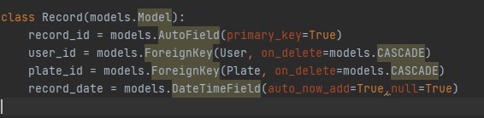
4. Recording licence plate number model
Notes:
模板来自于： 第一PPT https://www.1ppt.com/

Slide 10
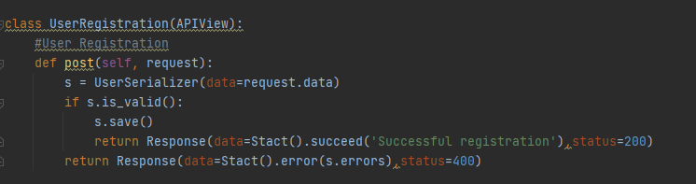
5.Add Owner
Notes:
模板来自于： 第一PPT https://www.1ppt.com/

Slide 11
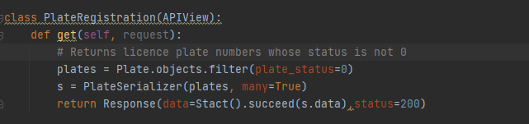
6. Return unregistered licence plate numbers,
as well as successful registration is not returned
Notes:
模板来自于： 第一PPT https://www.1ppt.com/

Slide 12
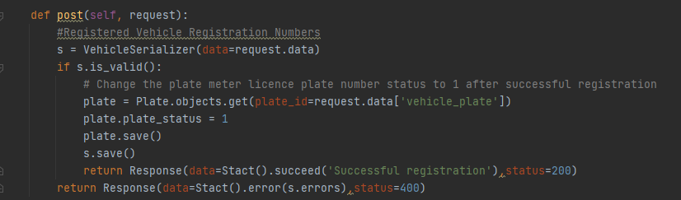
7. Register the car licence plate number,
enter the licence plate number and
the owner's id number for registration
Notes:
模板来自于： 第一PPT https://www.1ppt.com/

Slide 13
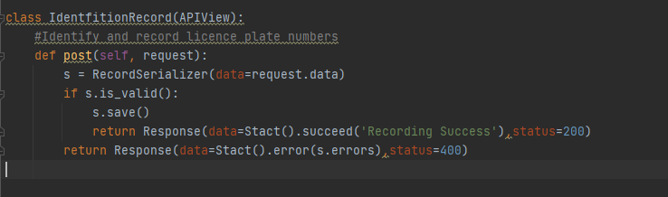
8. Record the licence plate number,
record the owner and licence plate number as well as
the current time
Notes:
模板来自于： 第一PPT https://www.1ppt.com/

Slide 14
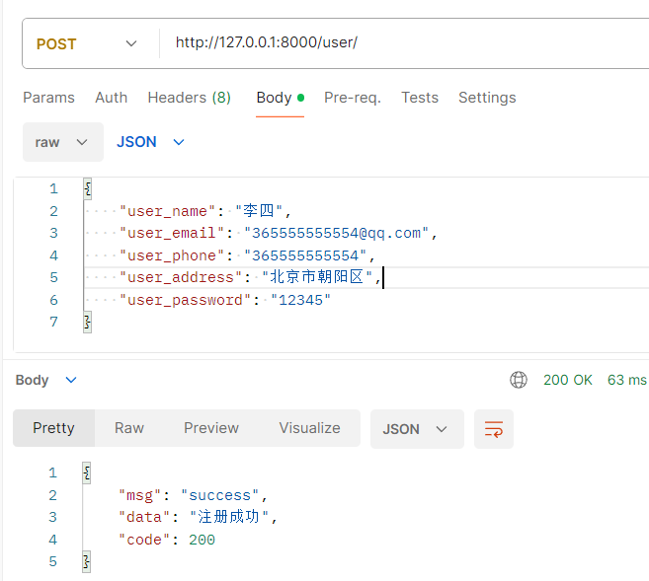
9.Test
-Owner Registration
-Post Write name,
email address,
mobile phone number,
address and password.
Notes:
模板来自于： 第一PPT https://www.1ppt.com/

Slide 15
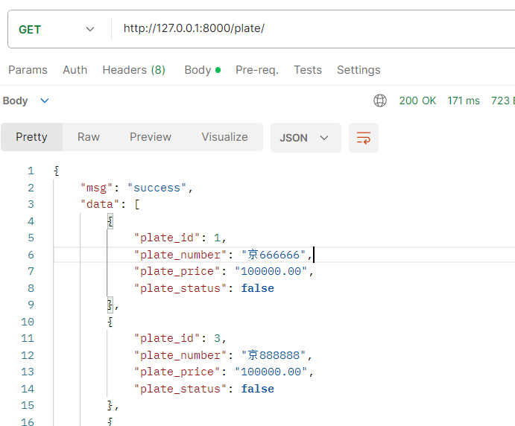
-Get Unregistered Licence Plate Number
-Get request
Notes:
模板来自于： 第一PPT https://www.1ppt.com/

Slide 16
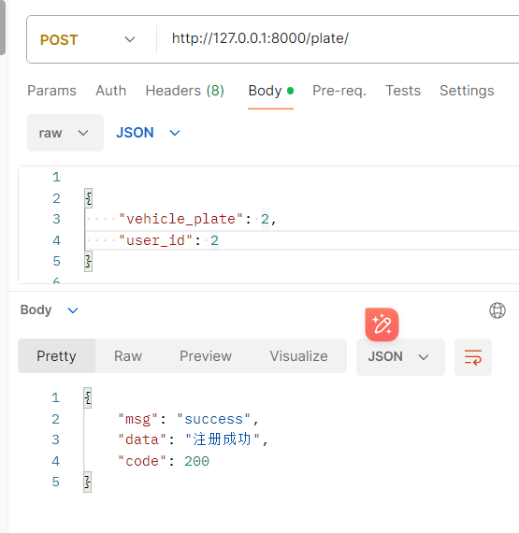
-Registration of licence plate number
-Post Write the licence plate number and owner of the car
Notes:
模板来自于： 第一PPT https://www.1ppt.com/

Slide 17
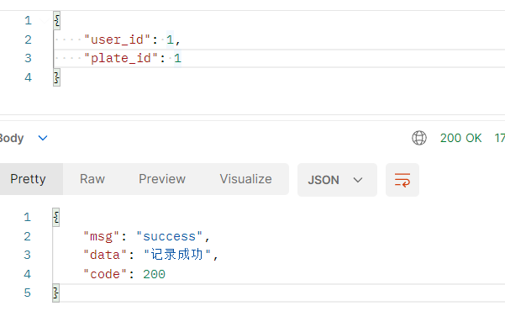
-Registration of licence plate number
-Post Write the licence plate number and owner of the car
Notes:
模板来自于： 第一PPT https://www.1ppt.com/

Slide 18
Thanks for watching.

